Slide 1
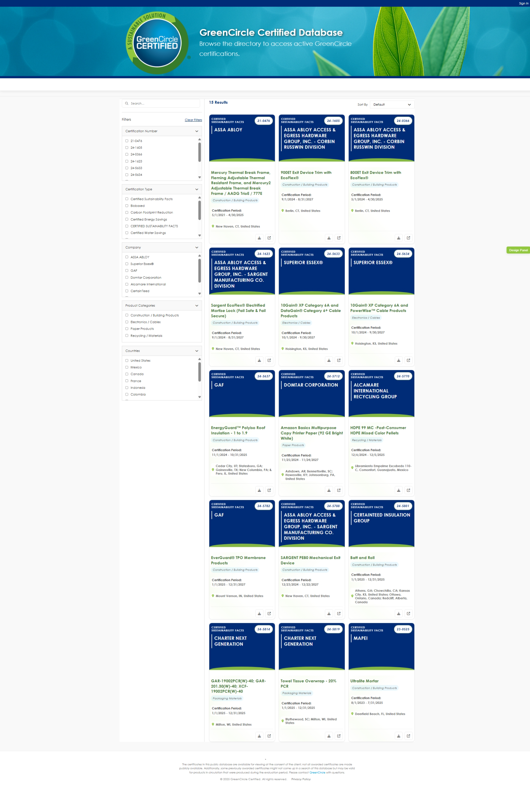
Web View (Public)
GLOBAL: Make sure you give more white padding around the exterior sides. The white box sometimes is very close to the grey area
Does this get underline based on style guide and links in footer? Is blue color right?
Why is this here? There could be thousands listed. It’s not listed in wires. They can search cert number by typing in search bar
GLOBAL: I think this text can be the grey/black you are using. Just keep the bold. The green is hard to read
Gave list in field requirements document, you are listing CSF twice, once all caps which is wrong. Make alphabetical. Will send updated list
Make sure on real site all the filter options are alphabetical
GLOBAL: Just make sure all the font sizes are big enough. It may be the screenshots making it be so small. Should not have anything less than 12 point / 16 pixel in body area
Product Categories should be before Company as in wires. Also missing levels
Global: This does not match the name we gave in the field requirements document. Should be
Electronics, Computers & Accessories
(we had “and” spelled out but if you need to abbreviate with ampersand we can)
List US first then list alphabetically
Missing Additional section (for external tags). As filter options right now you can add APR (Association of Plastic Recyclers), LEED
This does not match the name we gave in the field requirements document
Remove dot
Give link styling

Slide 2
Web View (public)

Slide 3

Web View (Admin)

Slide 4
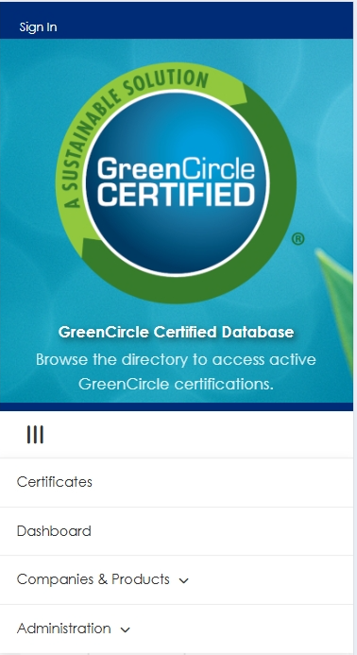
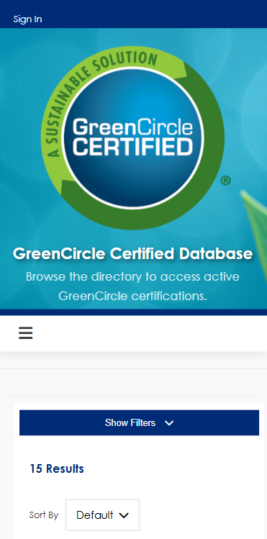
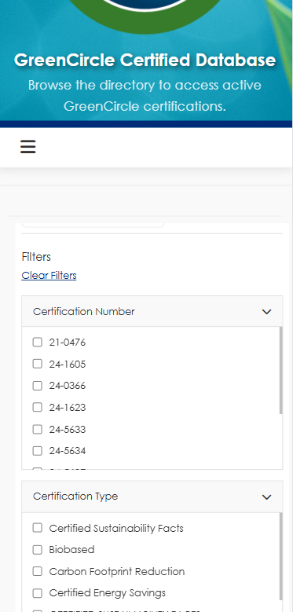
Option 4 – Final Option (mobile view)
Mobile View
GLOBAL: Usually when this is open this becomes an X to close out

Slide 5
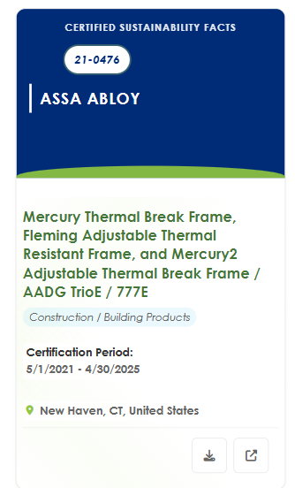
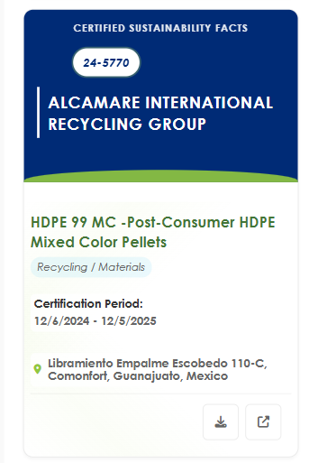
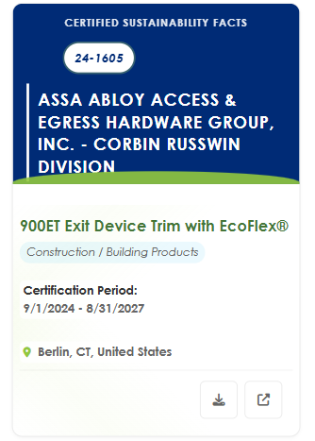
Option 4 – Final Option (mobile view)
Mobile View
Fix alignment
Fix

